Slide 1

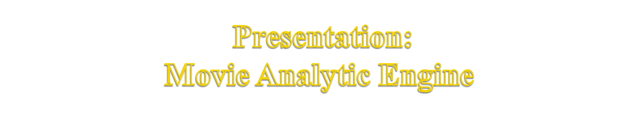
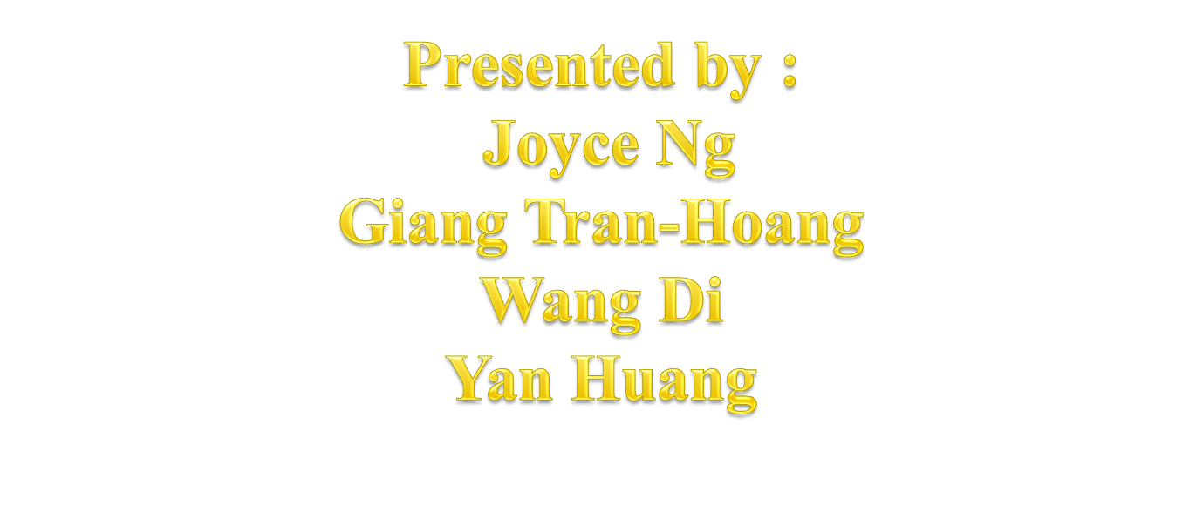

Slide 2
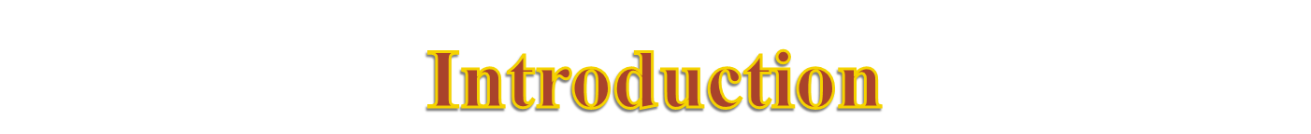
Prediction on the financial success of movies is crucial in a risky business like the film industry.
Building a movie prediction model is crucial for a movie producer who is keen to make money and minimise the risk of losing money.
Our movie analytics engine aims to make movie predictions for the financial success of movies based on the people’s (directors, actors and writers) participation.

Slide 3
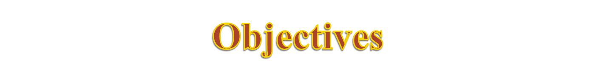
Getting sufficient clean movie data suitable for the model.
Building the index table containing people's score based on the movies they are in.
Building and validating the prediction models

Slide 4
Limited data collection tools and format of data returned requires plenty of data preprocessing work.
Database of movie titles are huge with missing information, inconsistent values, data format, data units and so on.
Requires data transformation from non-numerical input data to numerical data for it to be usable.
Requires a combination of techniques to be used.

Slide 5

“success” score of a movie is a combination of imdb users’ rating and financial rating.
Input data for each movie will be a vector of 5 dimensions containing the average score of its directors, writers, main actors, supporting actors and other actors respectively.
The score for each artist will be a weighted sum of the scores of all the movies he was in.
The predictor calculates the output score of a movie from the input vector using weighted sum of KNN.
The weights will be optimised with cost function built by K-fold cross-validation

Slide 6

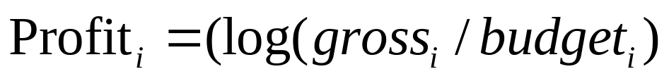
Data Collection
About 3700 movies ids were collected from imdb.com website with the year from 1970 onwards
Movies without gross and budget for US market or in currencies that are not USD were filtered out
Financial score is calculated and scaled to domain of (0,10):
Final success score is average value of user ratings and financial score above
Where

Slide 7
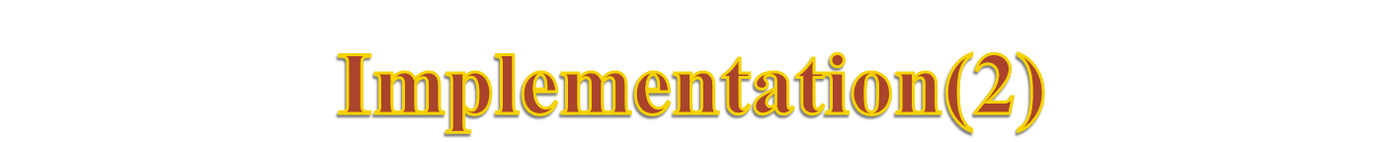
Data model
Initial input features
Features | Value
Director | Based on a weight of 4
Writer | Based on a weight of 1
Actor | Based on a weight of 3.5
Supporting Actors | Based on a weight of 1
Others | 0.5
Output is the name, score and total weight

Slide 8
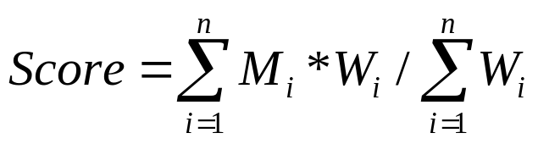
Calculating the people’s score based on category’s weight:
The people’s scores are saved in a csv file

Slide 9
Using the index to predict
  The score of an unknown movie can be calculated from the scores of the people in the movie retrieved from the index table
  If the a person is not in index, his score will be generated by normal distribution.
  The calculation can be done by KNN

Slide 10
10-fold Cross Validation:
  The whole data set is divided into 10 parts: We ran the validation for 10 times. In i-th time, the i-th part is used as the testing set and the rest are used as the training set. We use the summation to validate an assuming weight:
  Summation =
  ∑(estimated score – real score)²

Slide 11
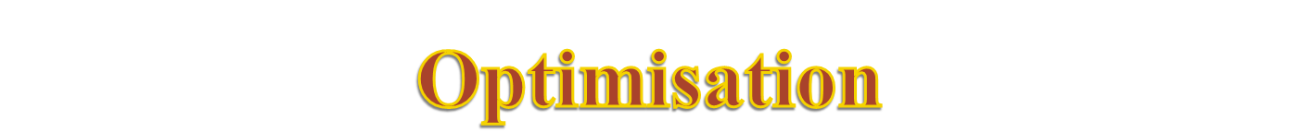
We use Genetic Algorithm (GA) to optimise the weights.
An individual in GA is a weight vector whose length is 5. The domain is [(3,6),(0.5,1.5),(3,7),(0.5,2),(0.5,0.5)]
There are 50 individuals in one generation. The first generation is generated randomly and only the best 10 individuals (elites) are chosen to generate off-springs by both mutation and cross-over.
The new generation consists of the elites and their off-springs.
Build a dictionary to improve the speed.

Slide 12
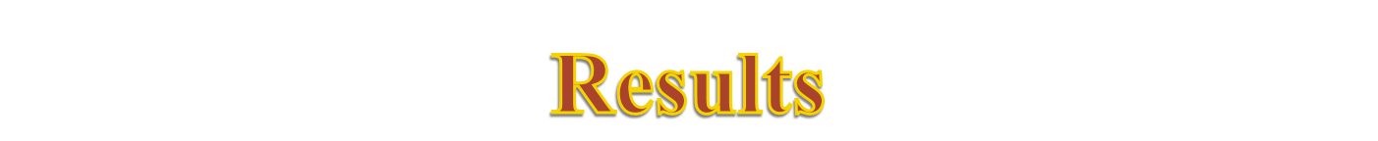
The optimisation runs with two models using weighted sum and KNN yield the results:
The accuracy of KNN is a little better than weighted sum. However, it does not improve the accuracy too much and its consuming time is 36 times bigger. Moreover, this difference will increase significantly if the sample size are larger.
 | The weighted sum | KNN
Sum error | 514.85 | 419.72
Time(second) | 519 | 18677
Optimised weight | [3.33, 0.7, 6.87, 1.96, 0.5] | [3.41, 0.95, 4.09, 0.59, 0.5]

Slide 13
Either weighted sum and KNN yield acceptable results with the average errors no more than 0.75 (over 10), but KNN is much slower.
So, we chose the weighted sum model as final.
The optimised weights on the full data set are:
[3.50, 1.30, 5.48, 1.90, 0.50]
With the average error of 0.73

Slide 14
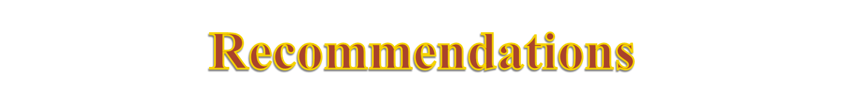
The weighted sum model is based on independence among all the features. The challenge is considering the combination of artists, which is similar to the 2-gram filter to classify spam and ham in our lab.
Train independent model for different genres of movies.
Predictor could be built such as using neutral network

Slide 15
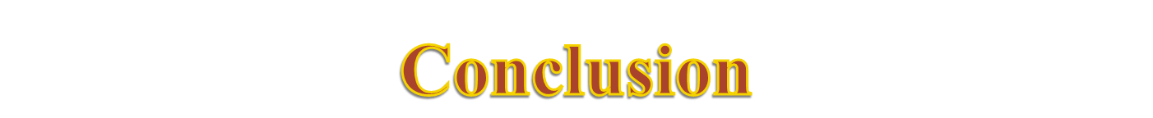
We spent a long time on data collection and pre-processing.
KNN model is computational intensive and has made only a little improvement on the accuracy.
GA avoids the local minimum issue efficiently.

